Slide 1

Debugging And Error Handling
Chapter 9

Slide 2
Learning Outcomes
Differentiate the FOUR(4) main types of errors
Use exception handling methods to handle errors
Debug a program

Slide 3
Error
To minimize the mistakes
We can identify the portions of code that are most prone to errors, to perform testing and exception handling
We can adhere to good coding practice that facilitate troubleshooting

Slide 4
Exception = Error
The exceptions are any error condition or unexpected behavior that occurs during the execution of a program, and consequently disrupts the normal flow of execution.
They can be because of user, logic or system errors.

Slide 5
4 Types of Errors
Parser Errors
Compilation Errors
Configuration Errors
Runtime /Logical Errors

Slide 6
Parser Error
Example:
<asp:TextBo ID=“txtID” runat=“server” />
Reference:
http://www.whatwg.org/specs/web-apps/current-work/multipage/syntax.html#parsing
Parse errors are only errors with the syntax of HTML.

Slide 7
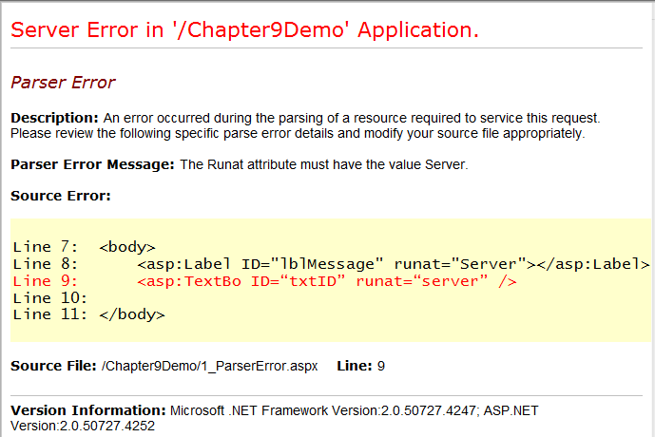
Parser Error

Slide 8
Compilation Error
Errors with the syntax of the statement, which cannot be recognized by the language compiler, such as C# or VB.NET
Example
if(x < 0 { lblMsg = “invalid value”; }
Can you identify the 2 syntax errors?

Slide 9
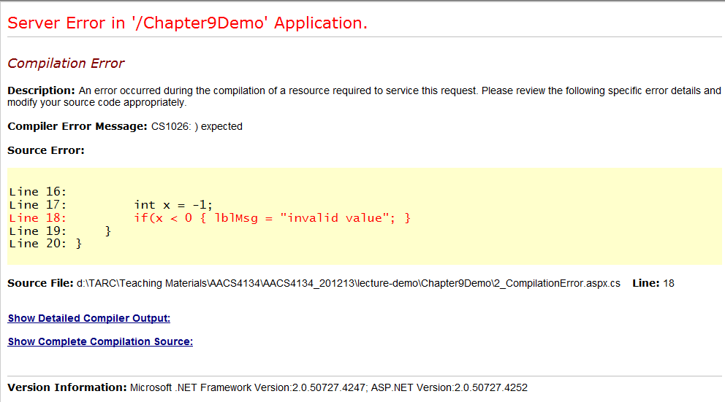
Compilation Error

Slide 10
Parser V.S. Compilation Errors
Parser Error
Compilation Error
occurs when there is a syntax error in the HTML code
It is raised when the page is in the process of being parsed
occurs when there is a syntax error in the C# code block
It is raised when the page is in the process of being compiled
Both involves Syntax Errors

Slide 11
Question
Discuss the similarity and a difference between Parser Error and Compilation Error.

Slide 12
Configuration Error
Caused by problem in either the Web.Config or the Machine.Config file.
Example of error:
Missing of </appSettings> in Web.config
Notes:
The configuration file in a Website is named Web.config
The Machine.config contains information that applies to every application on a single machine.
‹#›

Slide 13
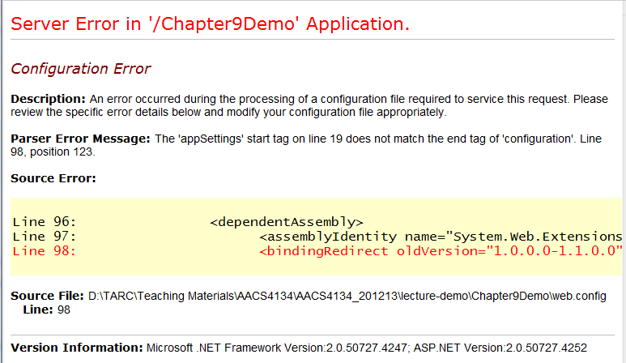
Configuration Error

Slide 14
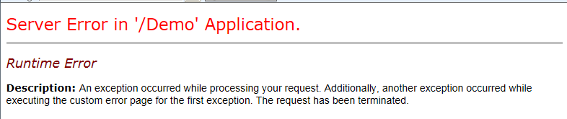
Runtime / Logical Error
Runtime error is error occurs during runtime, after a page is successfully compiled
Runtime/logical error cannot be detected by compiler
Logical error occurs due to logical error of the code.

Slide 15
Runtime Error vs. Logic Error
runtime error
logical error
Any error occurs during runtime, including logical error.
Example:
invalid query string
attempt to open a database connection which was not closed previously
Server failed
Error occurs due to invalid logic.
Example:
Attempt to convert a non-numeric value to integer
Attempt to divide a number by constant zero (e.g. 5/0)

Slide 16
Handle an exception
If no mechanism is used to handle these anomalies, the .NET run time environment provide a default mechanism, which terminates the program execution.
Exception handling is a built-in mechanism in .NET framework to detect and handle run time errors.

Slide 17
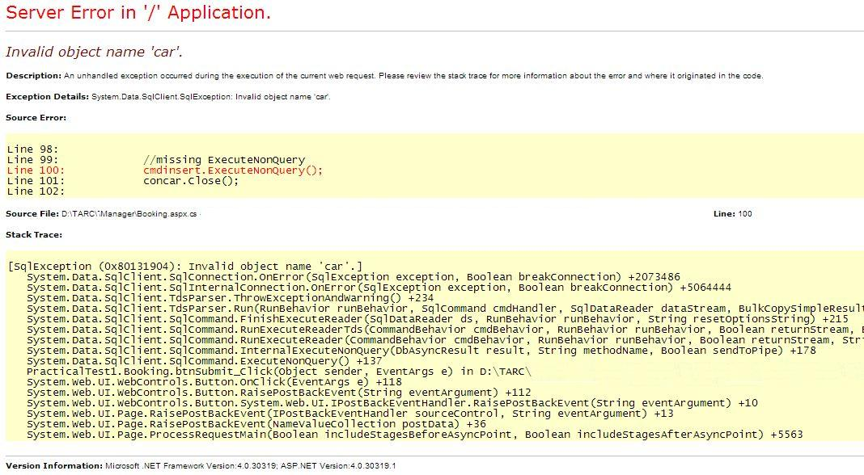
The .NET Default Exception Handling Mechanism
It is also called the Yellow Screen of Death (YSOD)

Slide 18
Standard Exceptions
Exceptions are represented within the .NET framework with instances of the Exception class.
The exception class consists of some standard properties that we always use to detect the exceptions.

Slide 19
Exception Class Properties
Properties | Description
Message | Returns a string that represents the error message.
Source | Returns a string representing the object or application that caused the error.
StackTrace | Returns a string that represents the methods called immediately before the error occurred.
TargetSite | Returns a MethodBase object that represents the method that caused the error

Slide 20
Exception Class Properties
1.
ex.Message
ex.Source
2.
4.
ex.TargetSite
3.
ex.StackTrace
The Exception Details YSOD Includes Information About the Exception

Slide 21
Exception Handling Methods
Page-Level Error Handling
try…catch… finally
Page_Error() method
Application-Level Error Handling
Application_Error() method

Slide 22
Page Level Error Handling
This method is used when we need to catch and handle any error that occurs in a page
use try…catch…finally to identify the portions of code that are more likely prone to errors
use Page_Error() method to handle any errors at the page level

Slide 23
Try…Catch…Finally
try encloses the statements that might throw an exception
try
{ //Statement which might fail at runtime }
catch (Exception e)
{ //Error handling block }
finally
{
//Statement is executed irrespective of the fact
that an exception has been raised
}
catch handles an exception if one exists
finally is optional. Use it if you like to FORCE the code enclosed to be executed
Notes:
try block
If any exception occurs inside the try block, the control transfers to the appropriate catch block.
catch block
Catch the exception, handle it, and later go to the finally block.
finally block
Statement in this block is FORCED to be executed irrespective of the fact that an exception has been raised. E.g. to close the database connection
‹#›

Slide 24
Page_Error() Method
Page error event is raised whenever there is an unhandled exception occur within a page.
You can catch and handle those unhandled errors that occur in a page by using the Page_Error( ) event handler.
Try…Catch

Slide 25
Page_Error() Method
void Button1_Click(object sender, EventArgs e)
{ int x = Convert.ToInt32("abc"); }
void Page_Error()
{
Response.Write("<p><h1>Sorry, there was an error:<br />");
Response.Write(Server.GetLastError().Message + "</h1></p>");
Server.ClearError(); //comment this line to see the difference
}
This error is unhandled
The GetLastError method returns the last exception thrown
To display the Message of the last exception thrown.
The ClearError method clears the last exception thrown.
Notes:
If you didn't call the ClearError method, the default error page generated by the ASP.NET framework would be displayed, and no one would ever see the polite apology.
‹#›

Slide 26
Application-Level Error Handling
We use Application_Error() Method to handle the errors in any page, regardless where they occur within an application
For example, we can use this event handler to log the errors to a log file, notify an administrator using email, or store the information into a database for debugging later.

Slide 27
Application_Error() Method
Write the Application_Error() event handler in the Global.asax file.
void Application_Error(object sender, EventArgs e)
{
// Code that runs when an unhandled error occurs
Application.Lock();
Application[“ErrorMsg"] += Server.GetLastError().Message;
Application.UnLock();
}
d:\Demo\4_RuntimeError.aspx.cs(18): error CS0020: Division by constant zero
Notes:
‹#›

Slide 28
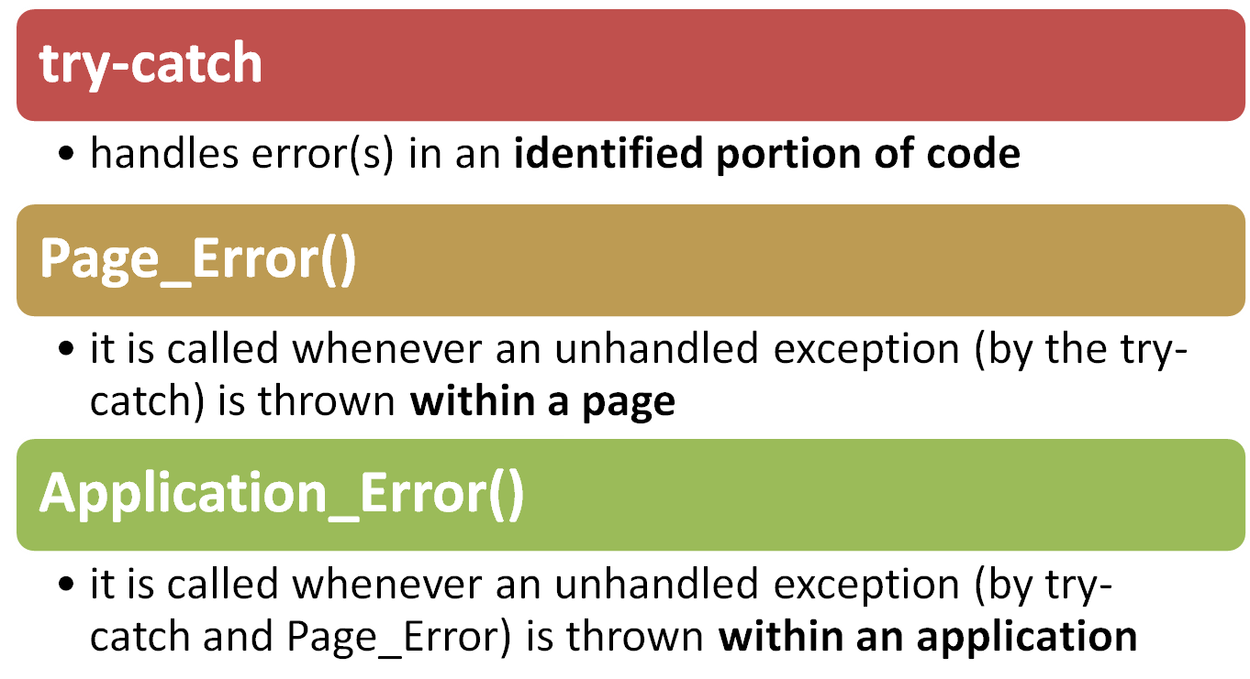
try-catch, Page_Error and Application_Error
Notes:
‹#›

Slide 29
Question
Why error handling is important? Suggest TWO (2) ways of handling runtime errors.

Slide 30
Questions
Refer to the following code, answer the following questions.
Line 1: void btnCal_Click(object sender, EventArgs e)
Line 2: {
Line 3: double Total = Convert.ToInt32(txtTotal.Text);
Line 4: double Amount = Convert.ToInt32(txtAmount.Text);
Line 5: lblAnswer.Text = Convert.ToString(Amount / Total);
Line 6: lblMsg.Text = “”;
Line 7: }
Identify and explain TWO potential errors that could be raised by the highlighted code above. Then name the type of the potential errors that you have suggested.
Suggest which exception approach is better to catch the potential errors in Q1 above, and justify your answer.
Write C# code to demonstrate how to handle the potential errors raised by the highlighted code above by using Page_Error() method.

Slide 31
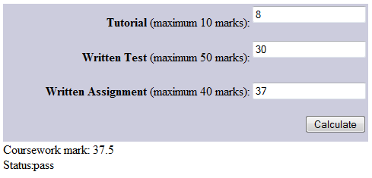
Questions
Assume that no validation is done on the form above. Predict and explain one runtime exception that can be caused by the user.
Discuss why would you use the Try…Catch block to handle the above error rather than the Page_Error() method.
Demonstrate in C# code, how to handle the potential exception as suggested in Q1 by using a try…catch code block.

Slide 32
Custom Error Pages
We should avoid public users to see the technical details of exception
We should provide them a more user-friendly custom-made error page
E.g. We would display different messages for page-not-found error and other errors
Custom Error Page allows us to map different types of errors to different page

Slide 33
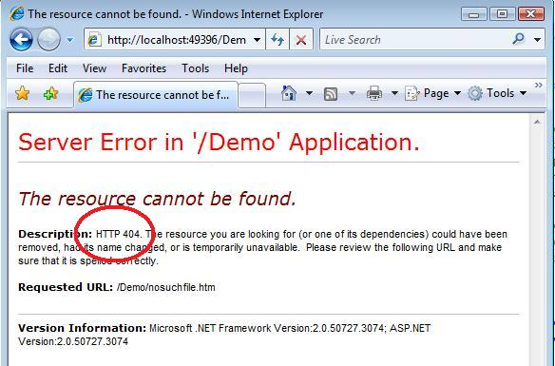
the YSOD that shows the HTTP status code

Slide 34

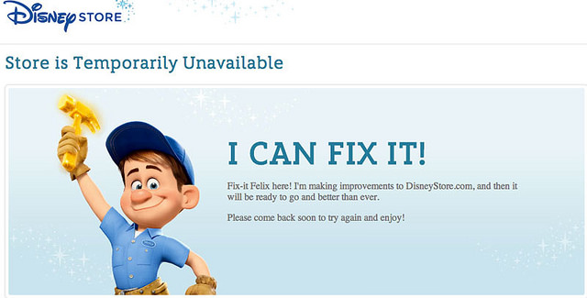
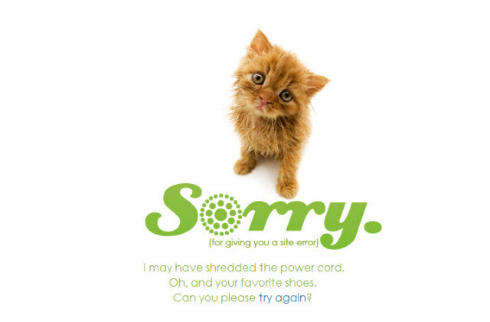
Examples of custom error page
Page not found
Page is made unavailable
Server error

Slide 35
Question
Discuss the benefits of using custom error pages in an application.
Notes:
Error pages are web pages shown to the website visitor when something has gone wrong with the web page they have requested. The error can be caused by different things, the most common is the 404 – File Not Found error. They will also been shown when there is a server error.
‹#›

Slide 36
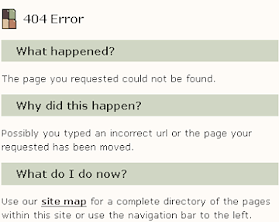
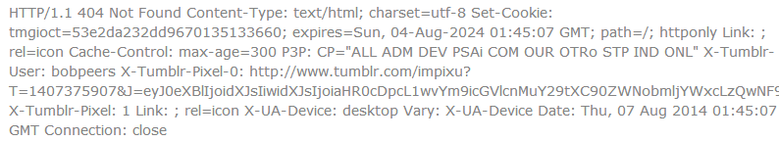
Designing a Custom Error Page
Include in the body (content) area:
The proper error code headers (it is for search engines and your server’s analytic software)
a precise description of what has happened, written in plain English, not a technical explanation.
a link to the website sitemap
by JAKOB NIELSEN (1998)
Response Code Header

Slide 37

Designing a Custom Error Page
Include in the body (content) area:
An Apology for the error
a list of possibly related links
a search box if you have website search enabled on the website.

Slide 38
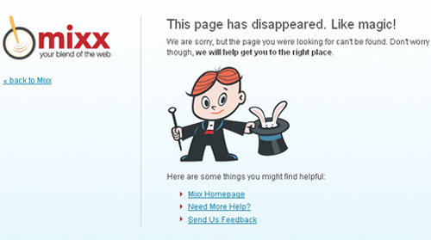
Designing a Custom Error Page
Include in the body (content) area:
A link to your homepage.
a contact form (or link to) so the visitor can notify you of the error.
see another example

Slide 39
Setting Custom Error Pages
mode attribute determines whether a visitor gets to see a detailed error page or not.
In Web.config
<configuration>
<system.web>
<customErrors mode=“On" defaultRedirect="errors/GenericErrorPage.htm">
<error statusCode="403" redirect="errors/NoAccess.htm"/>
<error statusCode="404" redirect="errors/FileNotFound.htm"/>
</customErrors>
</system.web>
</configuration>
On - custom error page is visible to both client (remote) and server (local).
Off – client (visitor) will see the .NET technical error page (YSOD)
RemoteOnly – client see the custom-error page; but the YSOD will be displayed at the server side.
HTTP status code

Slide 40
Question
Refer to the statements below, write the necessary code in Web.config in order to show the specific custom-made error pages to the users.
Display “Unauthorized.htm” page (error 401) when an authorized access occurs.
Display “NoSuchFile.htm” page (error 404) when a requested file is not found.
Display “ContactAdmin.htm” page when any other errors occur.
Notes:
‹#›

Slide 41
Basics of Debugging
Process of finding and fixing bugs in your code.
Working with bugs:
Setting breakpoints and Debug
Debugging Windows
Debugging JavaScript
Tracing

Slide 42
Setting Breakpoints
We set a breakpoint by pressing F9 on the line of code where we want to execution to halt.
When a breakpoint is hit during the debugging mode (F5), execution is stopped so that you can look at the code and gives us access to variables, controls, methods and much more.

Slide 43
Moving around in Debugged Code
F5 | Start Debugging
F11 | Execute the current line and step into a method being called
F10 | Execute the current line without stepping into the code that is being called
Shift + F11 | Complete the code in the current method and return to the code that initially call it
Shift + F5 | Stop debugging. Browser will be closed
Ctrl + Shift + F5 | Restart the debugging process

Slide 44
Debugging Windows
Watch Window – watch all variables
Locals Window – watch local variables
Breakpoints Window – overview of all breakpoints set
Call Stack Window – order in which code has been executed or called
Immediate Window – let you to execute code as if you had written it in a page. Use it to test expressions, see what functions return, etc.

Slide 45
Debugging JavaScript
Debugging JavaScript with VS2008 requires you to use IE (won’t work on other browsers)
Works on external js file and embedded JavaScript in the page.
Breakpoints can be placed on the JavaScript code.

Slide 46
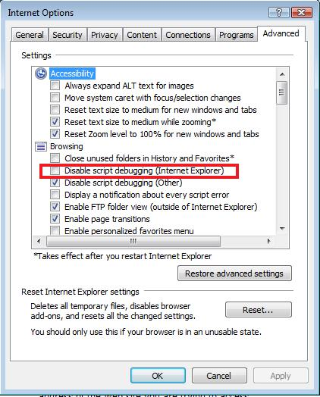

Slide 47
Tracing
Old day approach – create labels to display/trace the output one by one.
Cumbersome - need to create many labels
Ugly – may forget to remove the labels at the end
Performance affected by “extra” labels
Tracing allows your pages, controls and code to write information to a central location called “Trace”, which can then be shown in the browser.

Slide 48
Tracing (cont)
To enable tracing, we need to set the Trace attribute in the Page directive to True:
<%@ Page … Trace = “True” %>
A long list of details will be shown at the bottom of page when you run a trace-enabled page.

Slide 49
Debugging Tips
Never Do This
leave debug=“true” in the Web.Config file.
Set it to false to ensure solid operation of your site
Swallowing exceptions in a Catch block – leave the catch block empty.
It makes debugging difficult, can’t prevent error
Notes:
‹#›

Slide 50
Debugging Tips (cont)
Avoid exception handling if possible
Validation could be done so that can make exception handling unnecessary
Educate them, show them examples!
Do not assume your users know how to enter the right thing!

Slide 51
CONFIGURATION AND OPTIMIZATION
Next

